Slide 1
Designing and Developing PowerApps Portals
Notes:
This module introduces students to the Microsoft Power platform and explains the role of canvas apps, connectors and flows in building business solutions. The module introduces the Common Data Service for Apps (CDSA) and explains how it provides support for creating custom entities and building model-driven apps. Students will create canvas apps with PowerApps Studio and learn to write advanced expressions for screen and control properties. The module examines connectors and data binding and demonstrates using the Start with Data template. Along the way students will learn to build a canvas app for mobile devices that reads and writes customer data to a table inside an Excel workbook in OneDrive for Business.

Slide 2
Agenda
PowerApps Portal Architecture
Portal Editor
Portal Management App
Portal Configuration
Developing Web Templates

Slide 3
PowerApps Portals
Provides web development platform
Create websites that target authenticated users
Create websites that target anonymous users
Portal content managed by business users
Portal Editor used to add pages and author content
Portal Management App used to manage portal
Portal can be customized by web developers
Portal can be extended with custom web templates
Web templates can be written to access CDS entities

Slide 4
Agenda
PowerApps Portal Architecture
Portal Editor
Portal Management App
Portal Configuration
Developing Web Templates

Slide 5
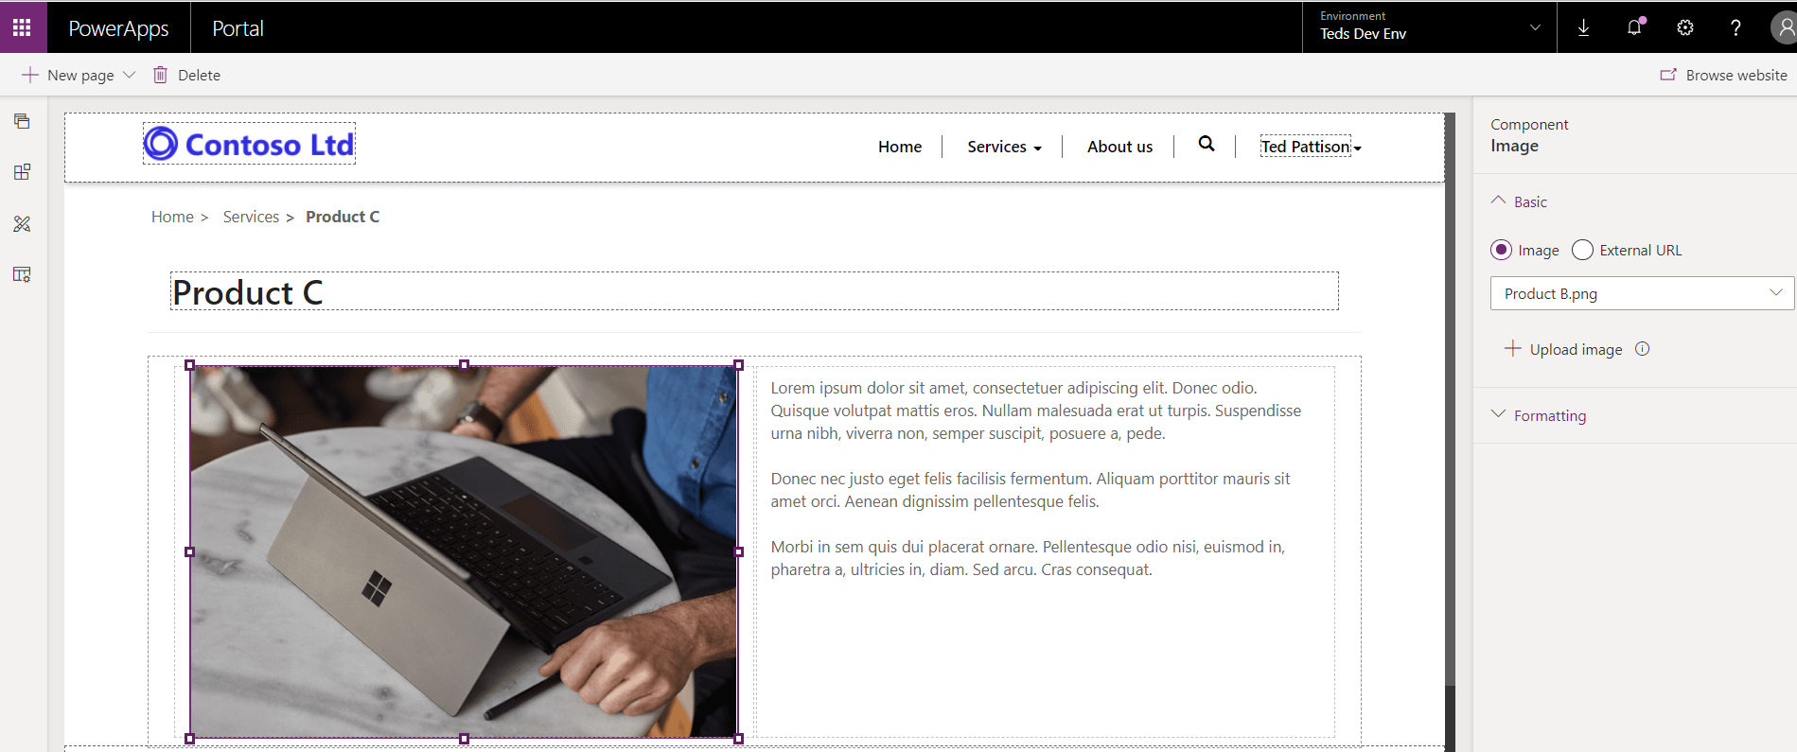
Portal Editor
Used to add pages and author page content
Designed for less-technical users
Editor not require web designer/developer skills

Slide 6
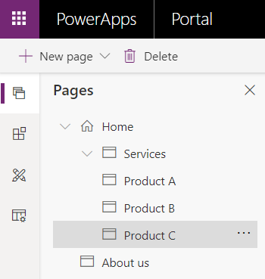
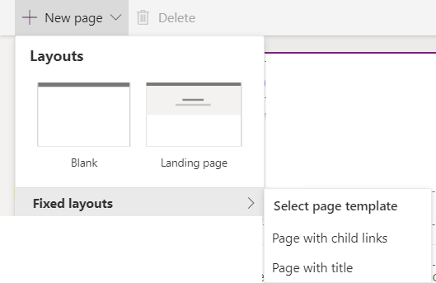
Adding and Navigating Pages
Pages tab provides navigation across pages
Pages added using New page menu button

Slide 7
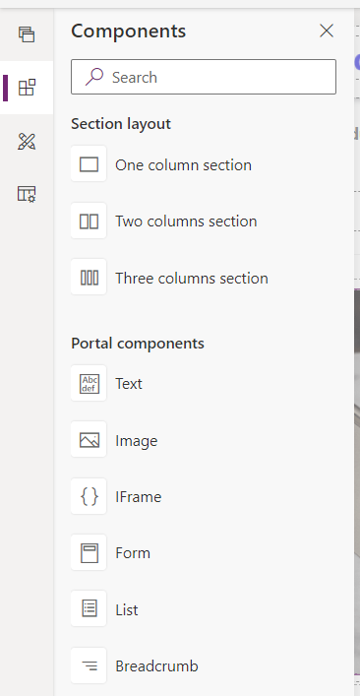
Adding Page Content using Components

Slide 8
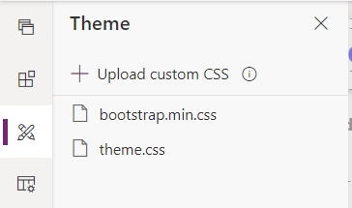
Themes
PowerApps portals styled using Bootstrap 3
Not practical to use a more recent version of bootstrap (e.g. v4)
theme.css file is provided for your custom styles

Slide 9
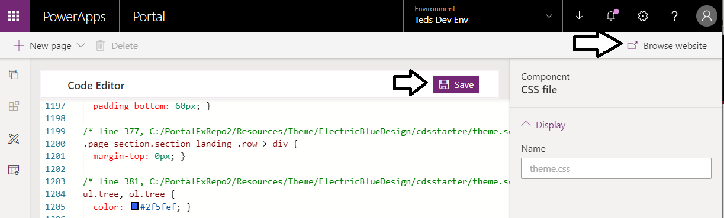
Seeing Your Changes in the Portal
Portal Editor provides Browse website button
Used to test how the portal will appear to others
Browse website clears cache to enabled development

Slide 10
Agenda
PowerApps Portal Architecture
Portal Editor
Portal Management App
Portal Configuration
Developing Web Templates

Slide 11
Agenda
PowerApps Portal Architecture
Portal Editor
Portal Management App
Portal Configuration
Developing Web Templates

Slide 12
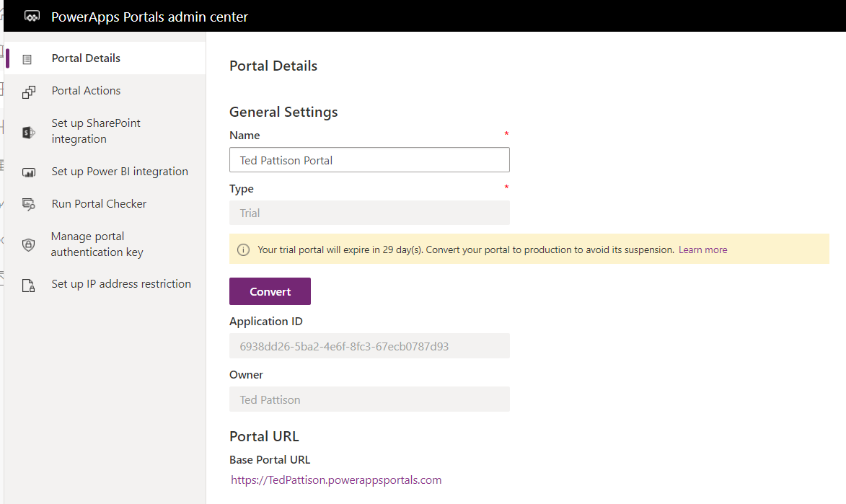
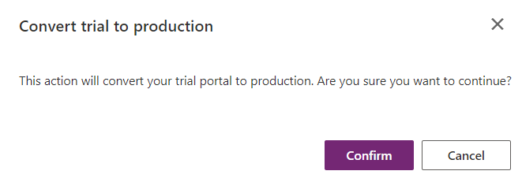
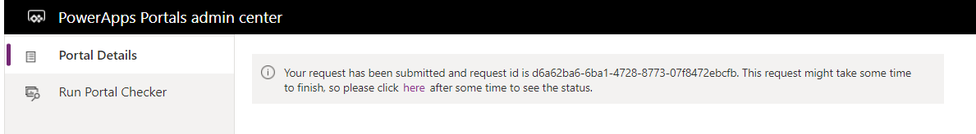
Configuring a PowerApps Portal

Slide 13
Agenda
PowerApps Portal Architecture
Portal Editor
Portal Management App
Portal Configuration
Developing Web Templates

Slide 14
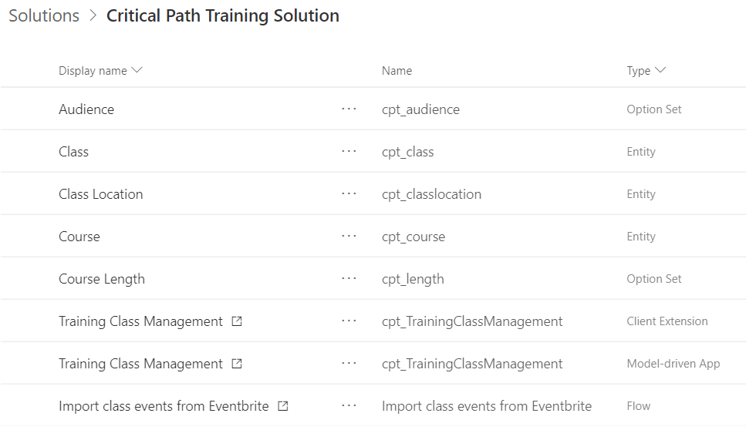
Creating a Solution with Custom Entities

Slide 15
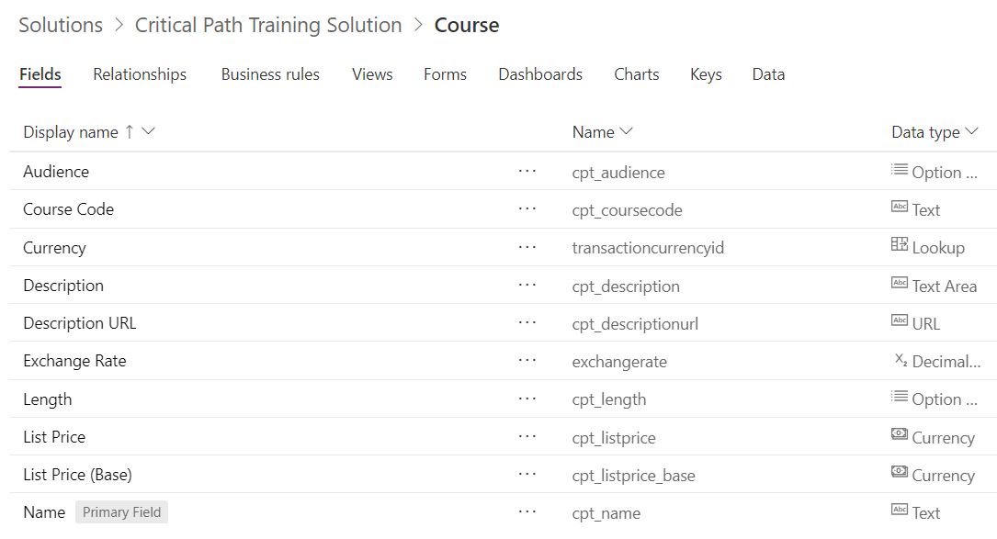
The Course Entity

Slide 16
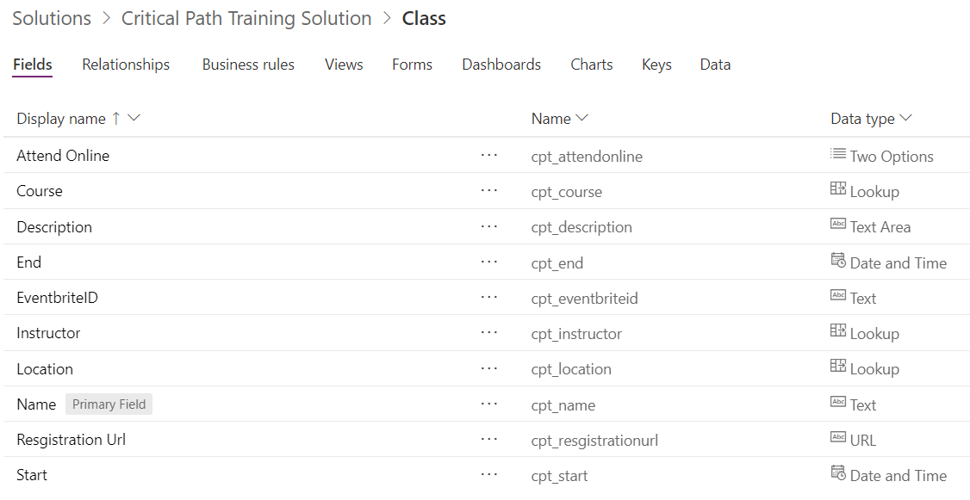
The Class Entity

Slide 17
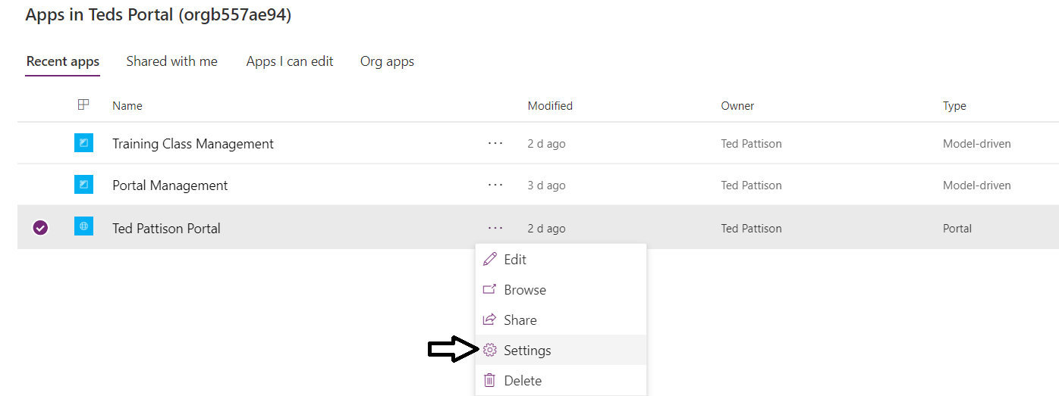
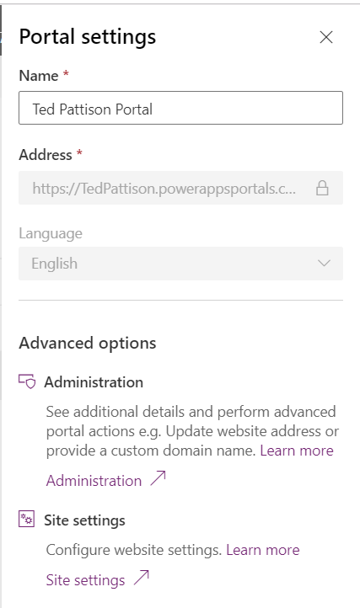
Converting a Portal to Production

Slide 18
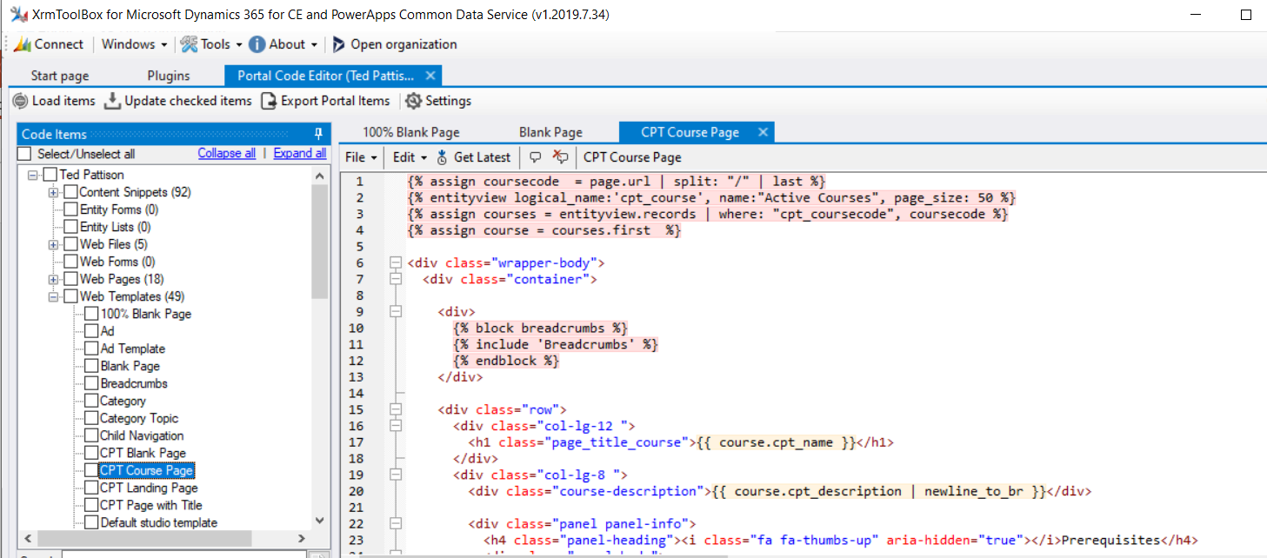
XrmToolbox
Authoring Tool for PowerApps Portals
Provides plug-ins for authoring and managing portals

Slide 19
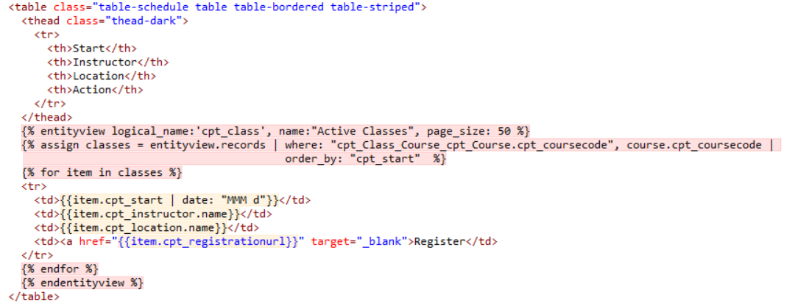
Web Templates and Liquid Language
Web Template created using Liquid scripting language
Can be used to access CDS data

Slide 20
Summary
PowerApps Portal Architecture
Portal Editor
Portal Management App
Portal Configuration
Developing Web Templates

